Slide 1
Graphical Models
Pattern Recognition, 2023

Slide 2
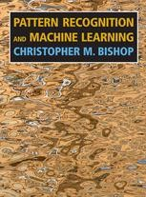
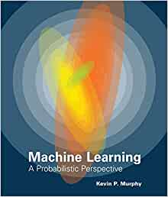
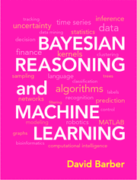
Main References
Pattern Recognition and Machine Learning (PRML), Christopher. M. Bishop, 2007
Machine Learning: A Probabilistic Perspective, Kevin P. Murphy, 2012
Bayesian Reasoning and Machine Learning (BRML), David Barber, 2020 (source codes available on the author’s website)
10-701 (Introduction to Machine Learning) and 10-708 (Probabilistic Graphical Models) in CMU, by Prof. Eric P. Xing
CPSC 440 (Advanced Machine Learning) in University of British Columbia, by Prof. Mark Schmidt

Slide 3
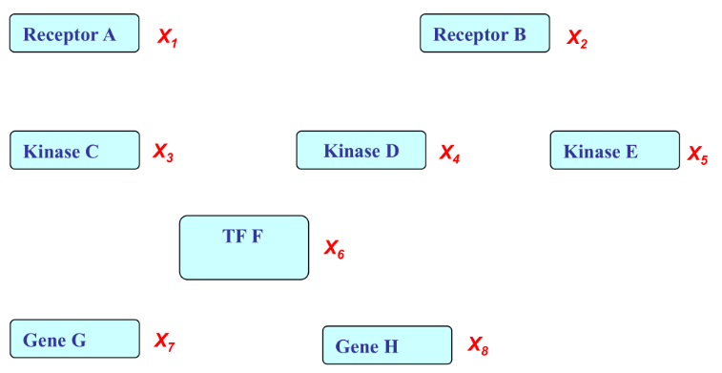
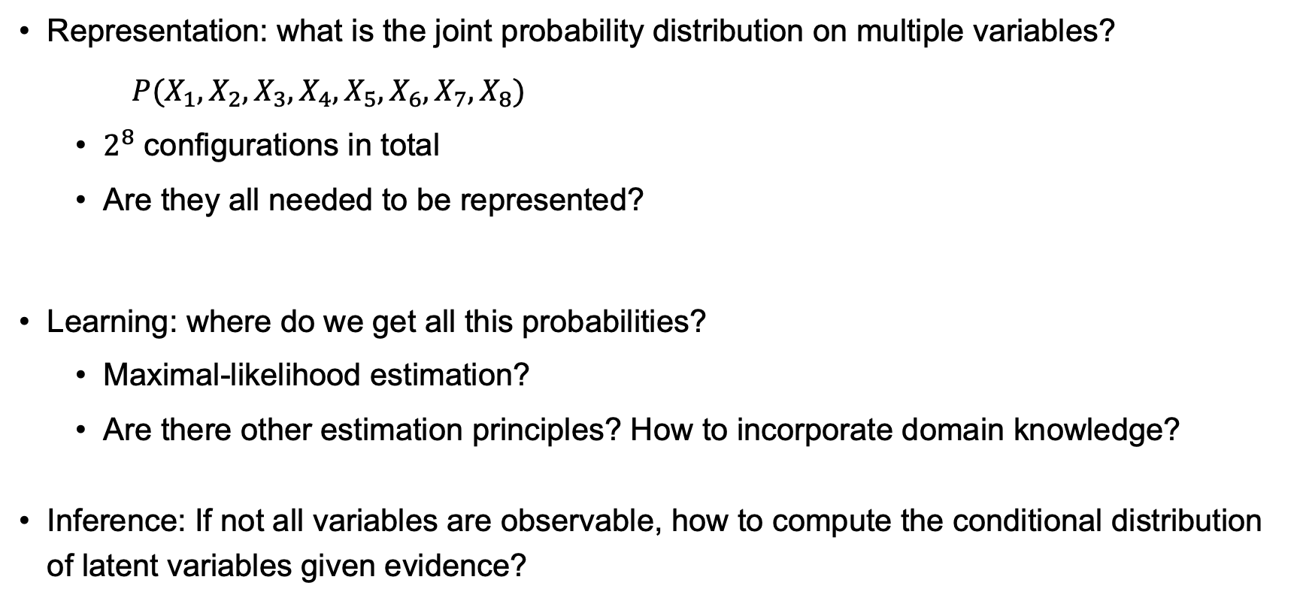
Recap of Basic Probability Concepts
Representation: what is the joint probability distribution on multiple variables?
$P(X_{1},X_{2},X_{3},X_{4},X_{5},X_{6},X_{7},X_{8})$
$2^{8}$ configurations in total
Are they all needed to be represented?
Learning: where do we get all this probabilities?
Maximal-likelihood estimation?
Are there other estimation principles? How to incorporate domain knowledge?
Inference: If not all variables are observable, how to compute the conditional distribution of latent variables given evidence?

Slide 4
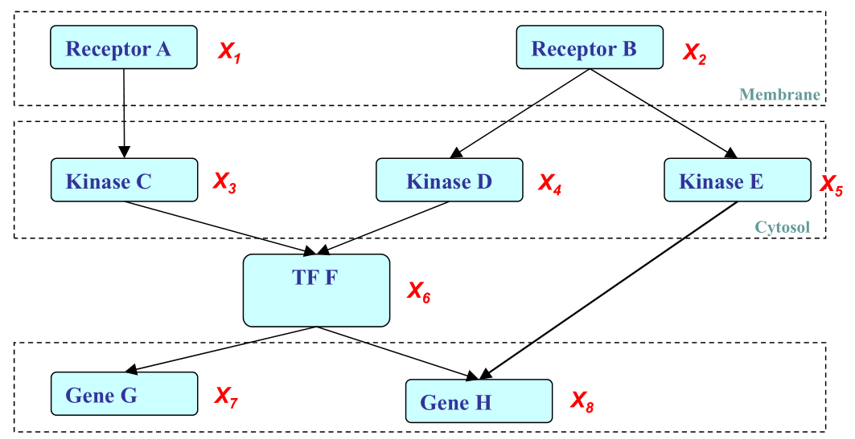

What is a (Probabilistic) Graphical Model?
Structure Simplifies Representation
In a nutshell
PGM = Multivariate Statistics + Structure
GM = Multivariate Objective Function + Structure
Notes:
Gene expression signaling pathways in a cell.
TF: transcription factor.

Slide 5




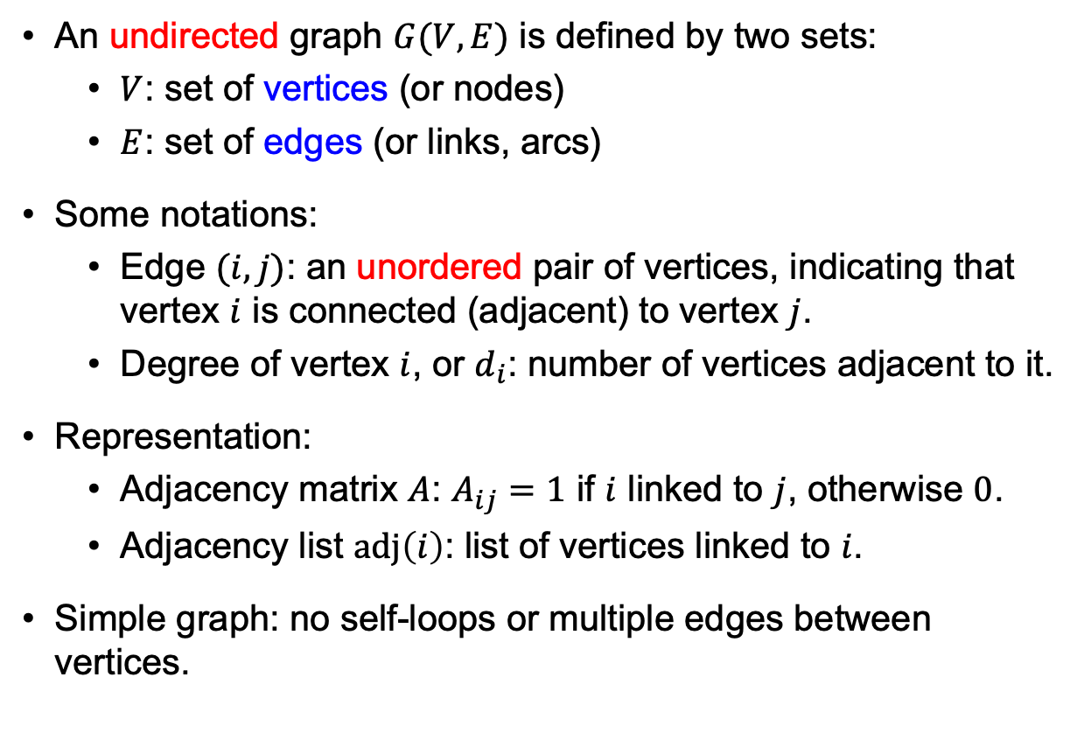
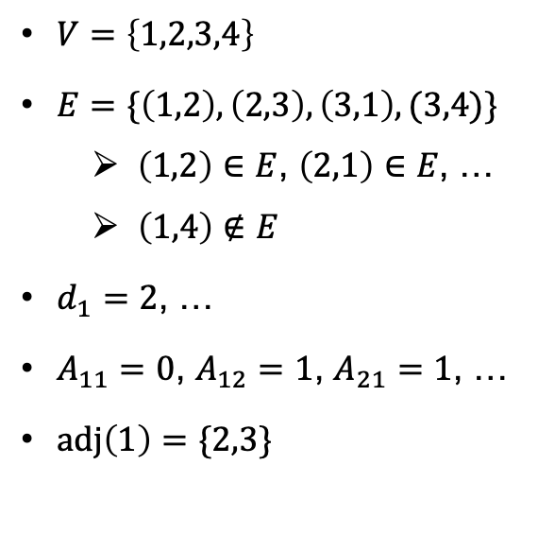
What is a Graph?
An undirected graph $G(V,E)$ is defined by two sets:
$V$: set of vertices (or nodes)
$E$: set of edges (or links, arcs)
Some notations:
Edge $(i,j)$: an unordered pair of vertices, indicating that vertex $i$ is connected (adjacent) to vertex $j$.
Degree of vertex $i$, or $d_{i}$: number of vertices adjacent to it.
Representation:
Adjacency matrix $A$: $A_{ij}=1$ if $i$ linked to $j$, otherwise $0$.
Adjacency list $adj\left(i\right)$: list of vertices linked to $i$.
Simple graph: no self-loops or multiple edges between vertices.
$V=\left\{1,2,3,4\right\}$
$E=\{\left(1,2\right),\left(2,3\right),\left(3,1\right),(3,4)\}$
$\left(1,2\right)∈E$, $\left(2,1\right)∈E$, …
$\left(1,4\right)∉E$
$d_{1}=2$, …
$A_{11}=0$, $A_{12}=1$, $A_{21}=1$, …
$adj\left(1\right)=\{2,3\}$

Slide 6
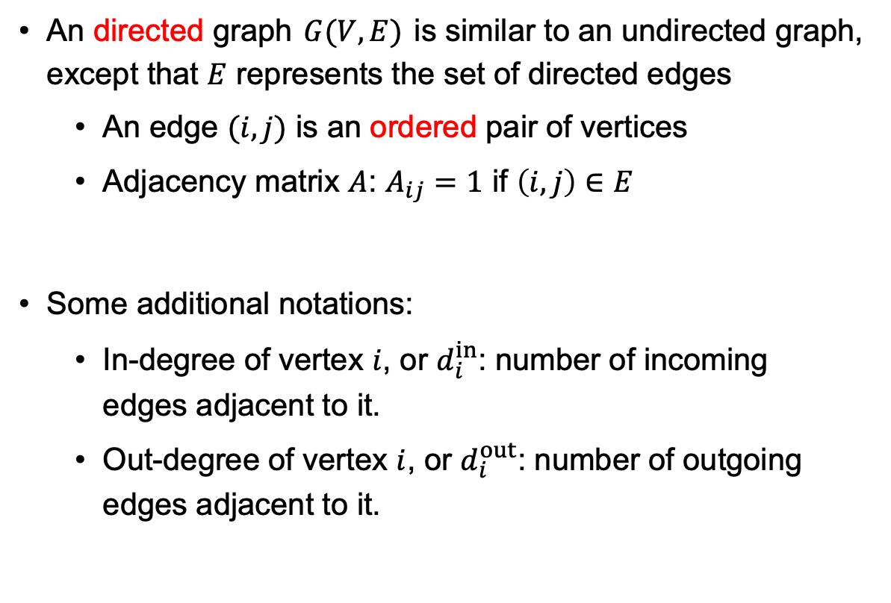
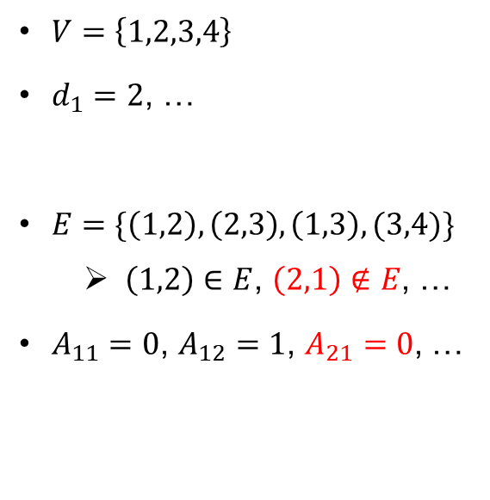
Directed Graphs
An directed graph $G(V,E)$ is similar to an undirected graph, except that $E$ represents the set of directed edges
An edge $(i,j)$ is an ordered pair of vertices
Adjacency matrix $A$: $A_{ij}=1$ if $\left(i,j\right)∈E$
Some additional notations:
In-degree of vertex $i$, or $d_{i}^{in}$: number of incoming edges adjacent to it.
Out-degree of vertex $i$, or $d_{i}^{out}$: number of outgoing edges adjacent to it.
$V=\left\{1,2,3,4\right\}$
$d_{1}=2$, …
$E=\{\left(1,2\right),\left(2,3\right),\left(1,3\right),(3,4)\}$
$\left(1,2\right)∈E$, $\left(2,1\right)∉E$, …
$A_{11}=0$, $A_{12}=1$, $A_{21}=0$, …

Slide 7
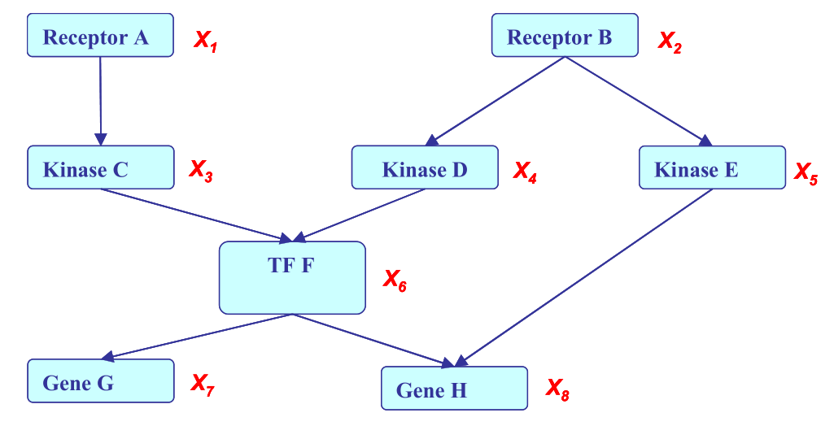
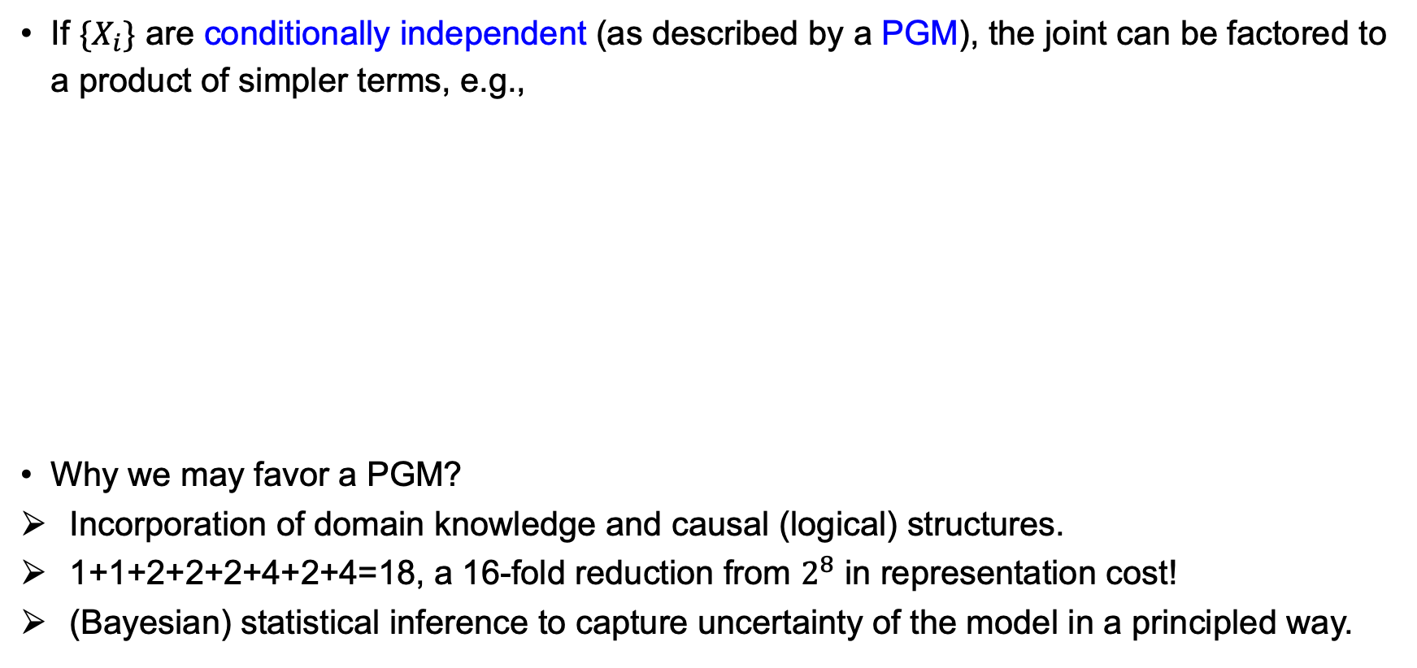
Probabilistic Graphical Model
If $\{X_{i}\}$ are conditionally independent (as described by a PGM), the joint can be factored to a product of simpler terms, e.g.,
Why we may favor a PGM?
Incorporation of domain knowledge and causal (logical) structures.
1+1+2+2+2+4+2+4=18, a 16-fold reduction from $2^{8}$ in representation cost!
(Bayesian) statistical inference to capture uncertainty of the model in a principled way.
Notes:
Representation cost: need a number for representing P(X1), two numbers for P(X3|X1), etc.

Slide 8
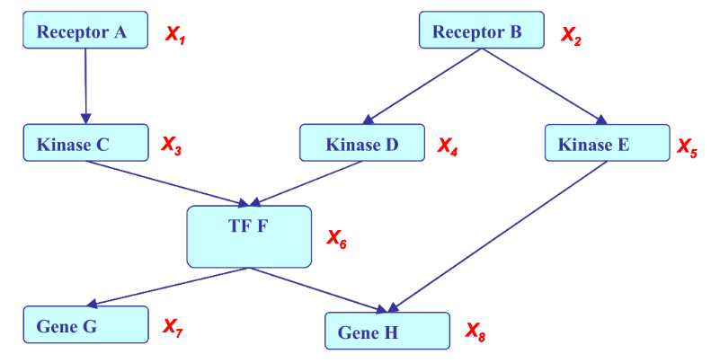
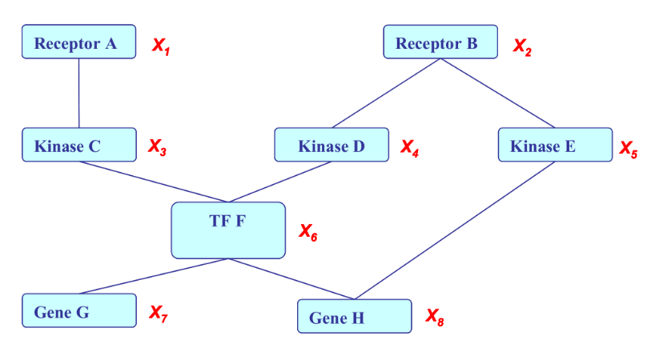
Two types of Graphical Models
Directed GM: Represent joint distributions that factorize into conditional distributions
E.g., Belief network or Bayesian network
Undirected GM: Represent joint distributions that factorize into “potentials”
E.g., Markov Random Field

Slide 9
Directed Graphical Models (DAGs)

Slide 10
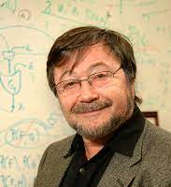
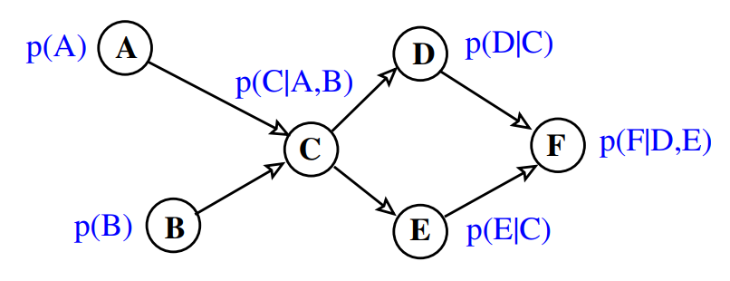
Belief Networks (Bayesian Networks)
Probability distributions defined on a directed acyclic graph (DAG):
E.g.
Probability + graph theory: independence assumptions among the variables
Inference (e.g., marginalizing and conditioning): simple operations on the graph
Benefit in computational efficiency
Natural for representing causal relations
J. Pearl

Slide 11
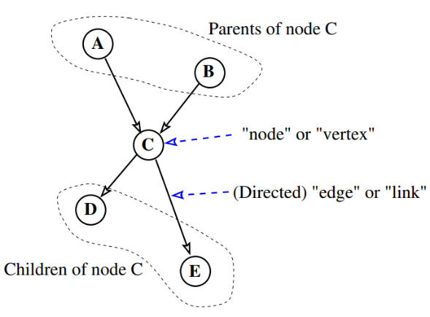
Notations used in Directed GMs

Slide 12
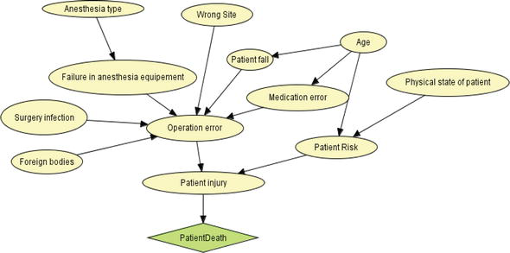
Belief Network Application – Risk Assessment
Risk assessment in healthcare system
https://www.intechopen.com/chapters/67527

Slide 13
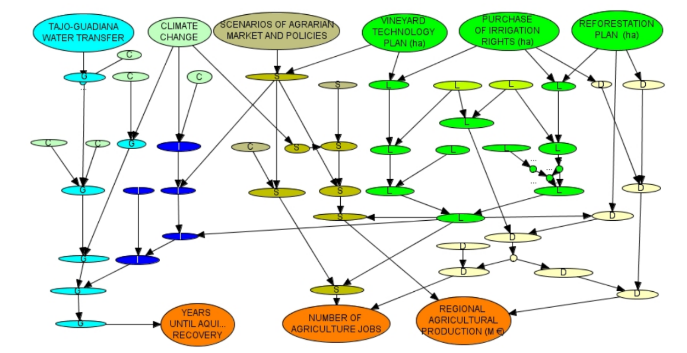
Belief Network Application – Water Resource Management
Water Resource Management
https://www.jstor.org/stable/26268156

Slide 14
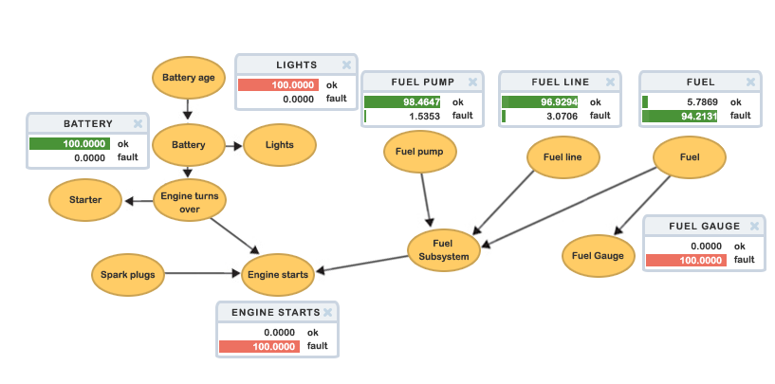
Belief Network Application – Commercial
Some companies sell software to help companies reason using belief networks.
https://www.hugin.com/technology/

Slide 15
Conditional Independence and Graph Structure

Slide 16
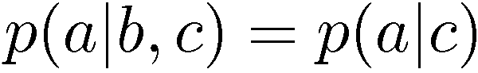
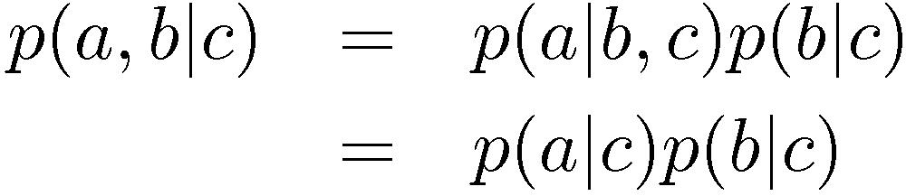
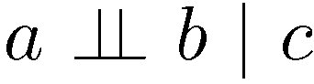
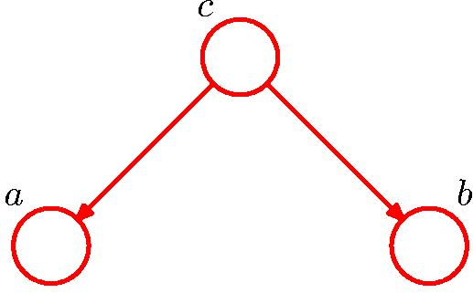
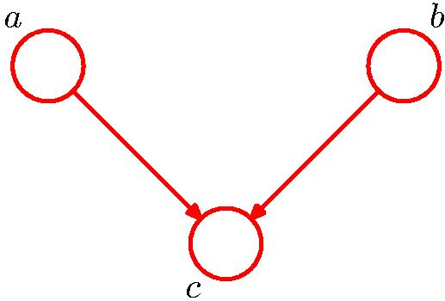
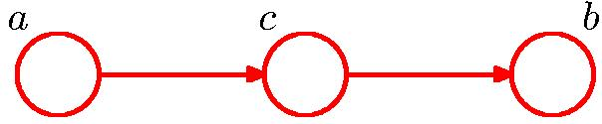
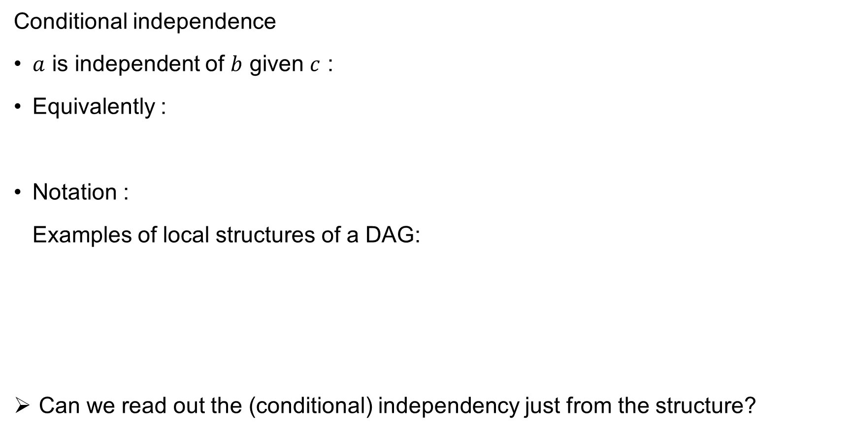
Conditional Independence and Graph Structure
Conditional independence
$a$ is independent of $b$ given $c$ :
Equivalently :
Notation :
Examples of local structures of a DAG:
Can we read out the (conditional) independency just from the structure?

Slide 17
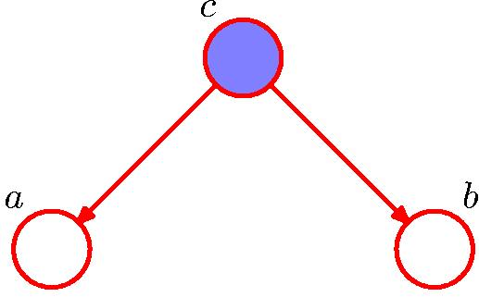
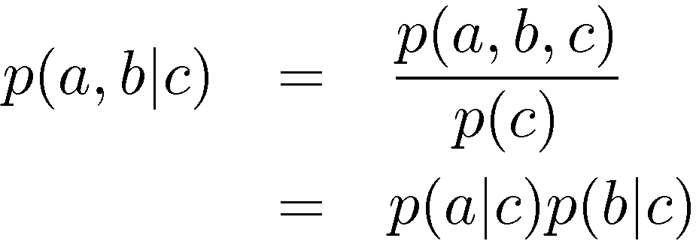
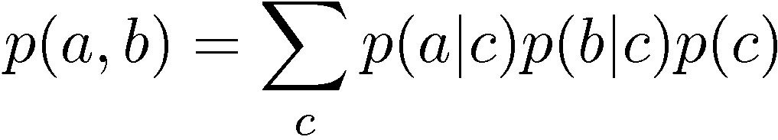
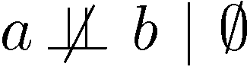
Conditional independence – Example 1
(Marginal dependent)
(Conditional independent)
$c$ : tail-to-tail with respect to the path from $a$ to $b$
Knowing $c$ makes $a$ and $b$ conditionally independent

Slide 18
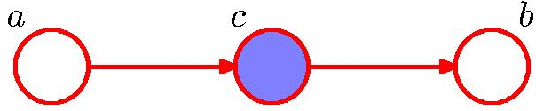
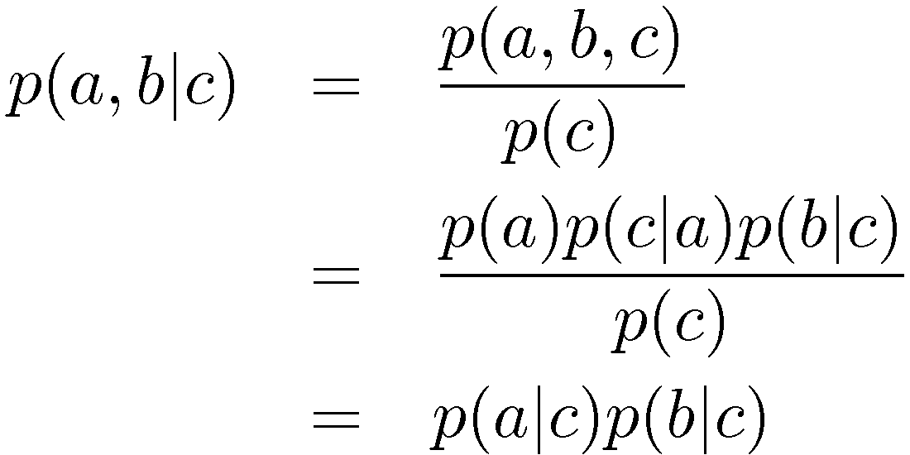
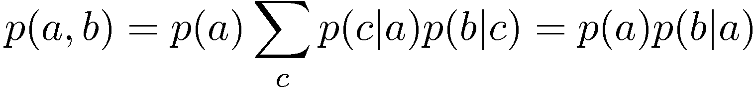
Conditional independence – Example 2
(Marginal dependent)
(Conditional independent)
$c$ : head-to-tail with respect to the path from $a$ to $b$
Knowing $c$ makes $a$ and $b$ conditionally independent

Slide 19
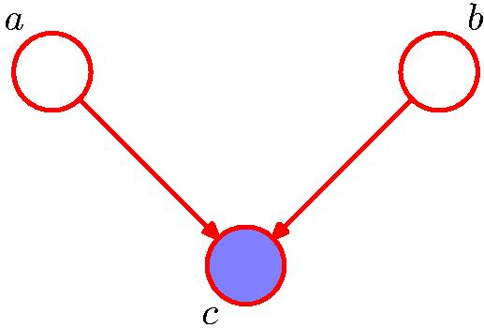
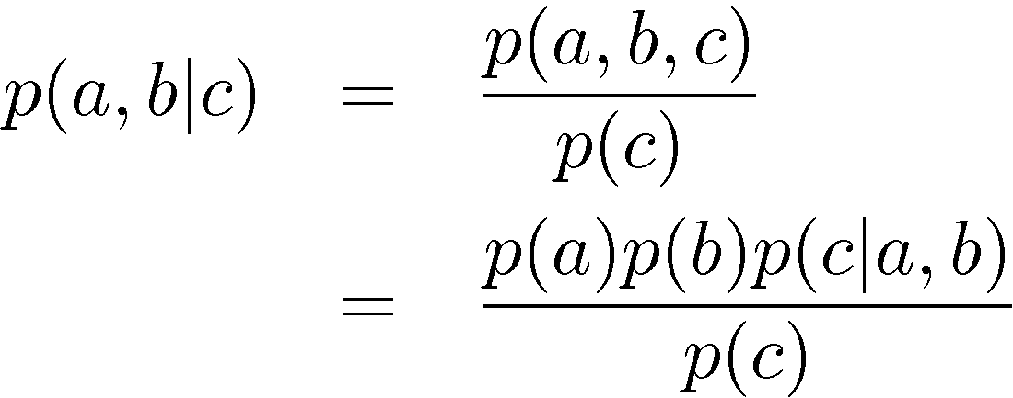
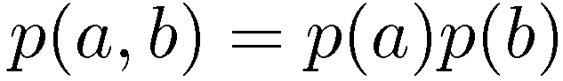
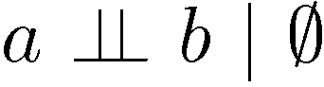
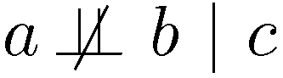
Conditional independence – Example 3
(Marginal independent)
(Conditional dependent)
$c$ : head-to-head with respect to the path from $a$ to $b$
Knowing $c$ makes $a$ and $b$ conditionally dependent (opposite to previous two cases)

Slide 20
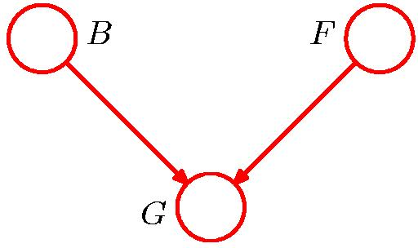
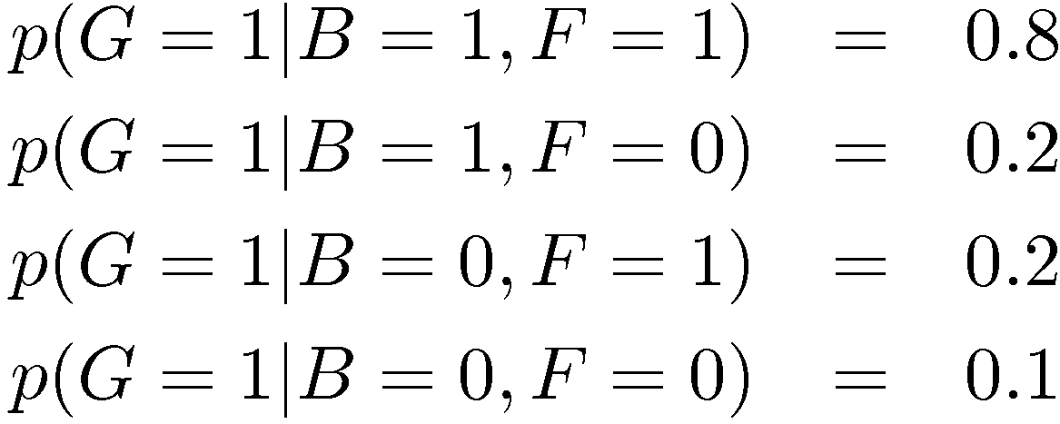
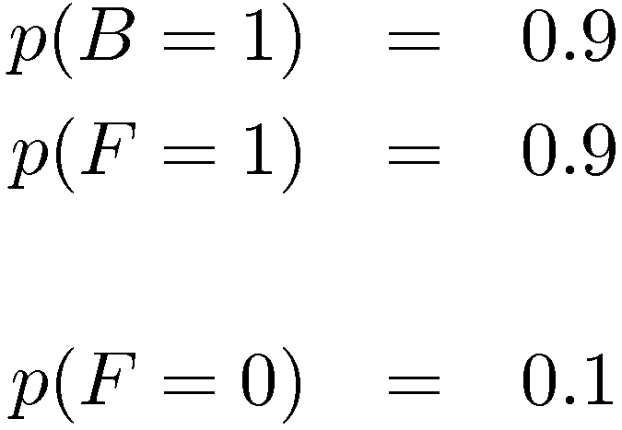
“Am I out of fuel?”
It is worth further understanding the unusual behavior of Example 3.
Consider the following example
B = Battery (0=flat, 1=fully charged)
F = Fuel Tank (0=empty, 1=full)
G = Gauge Reading (0=empty, 1=full)
and hence
Notes:
This example is like a probabilistic AND gate.

Slide 21
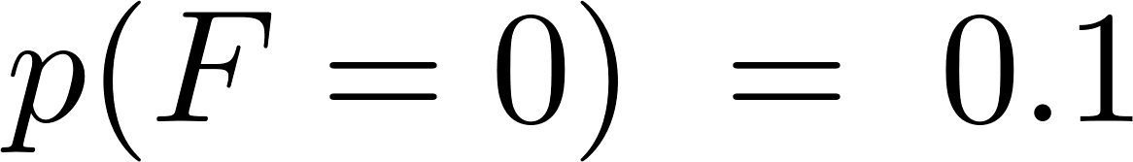
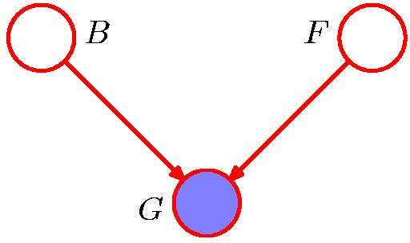
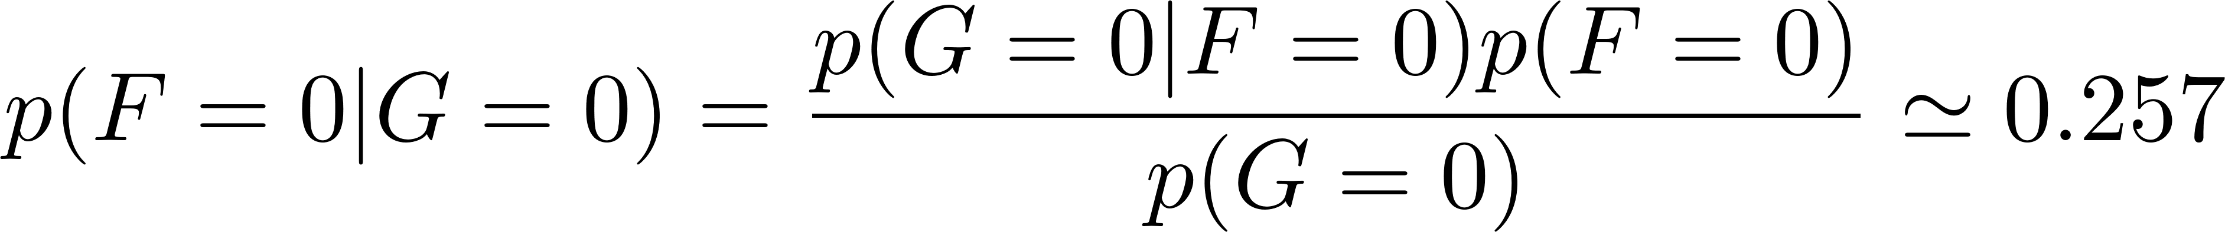
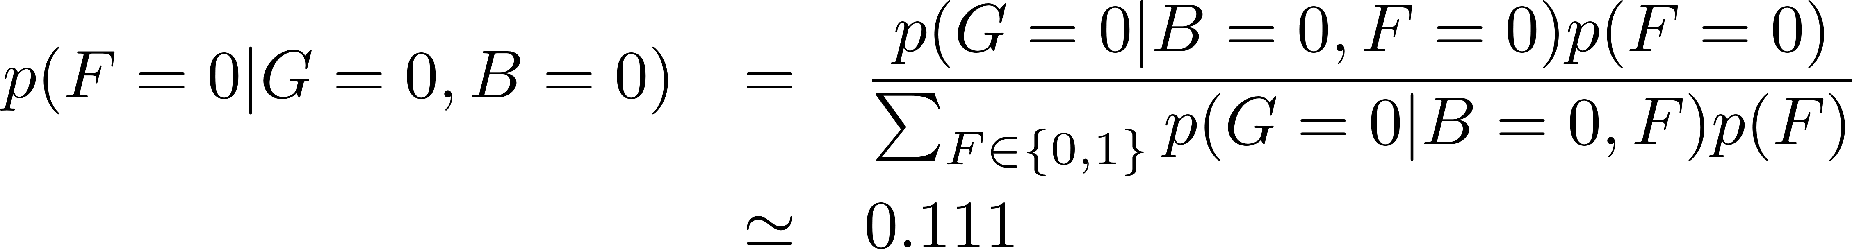
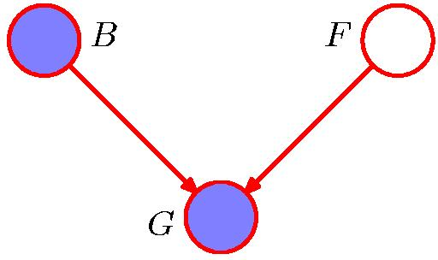
“Am I out of fuel?”
B = Battery
F = Fuel Tank
G = Gauge Reading
Probability of an empty tank increased by observing G = 0.
Probability of an empty tank reduced by observing B = 0.
This is referred to as “explaining away”.

Slide 22

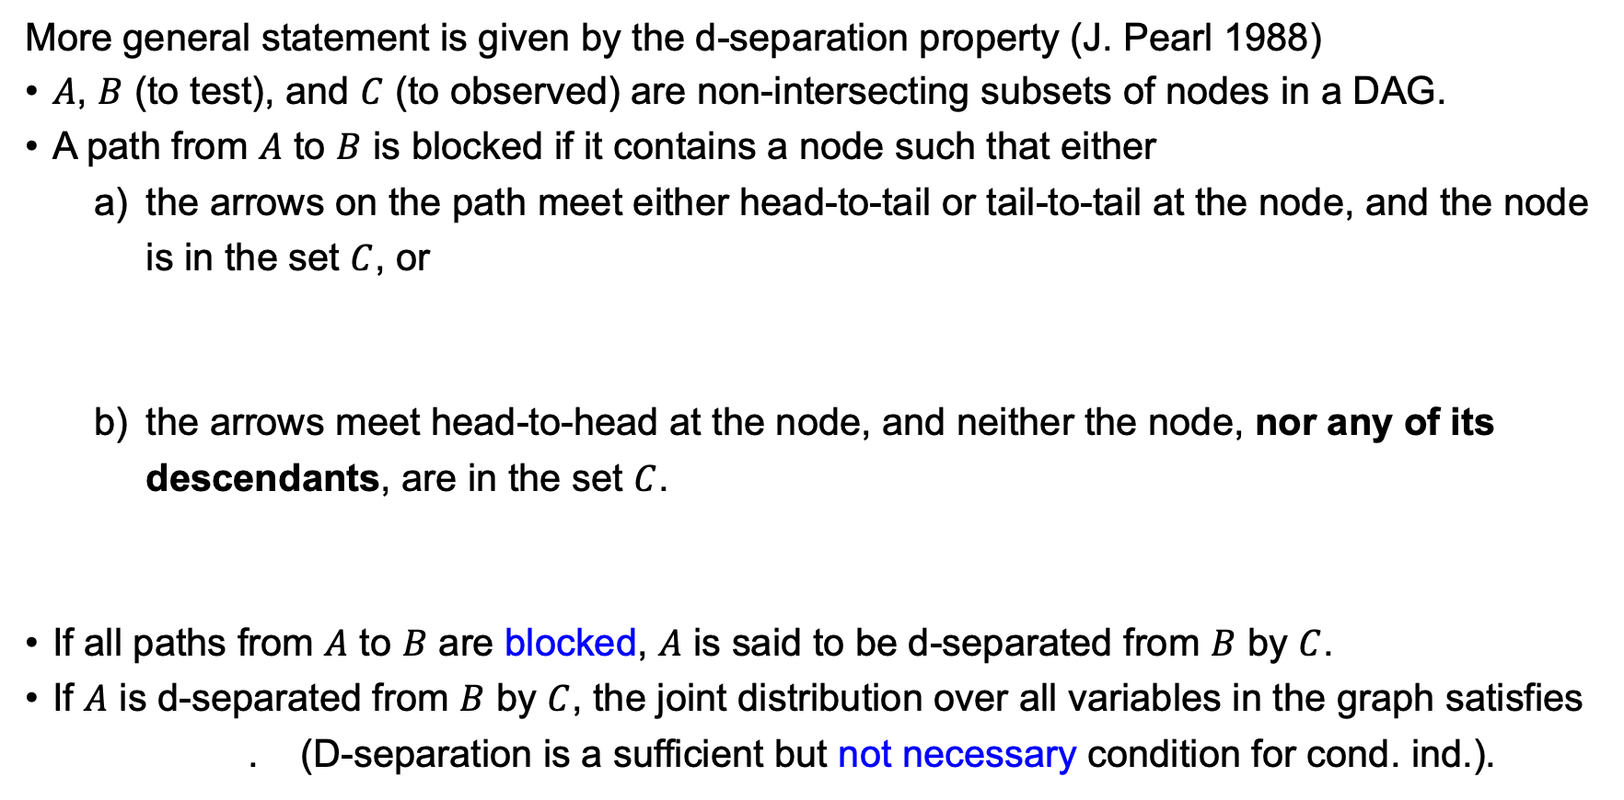
D-separation
More general statement is given by the d-separation property (J. Pearl 1988)
$A$, $B$ (to test), and $C$ (to observed) are non-intersecting subsets of nodes in a DAG.
A path from $A$ to $B$ is blocked if it contains a node such that either
the arrows on the path meet either head-to-tail or tail-to-tail at the node, and the node is in the set $C$, or
the arrows meet head-to-head at the node, and neither the node, nor any of its descendants, are in the set $C$.
If all paths from $A$ to $B$ are blocked, $A$ is said to be d-separated from $B$ by $C$.
If $A$ is d-separated from $B$ by $C$, the joint distribution over all variables in the graph satisfies
. (D-separation is a sufficient but not necessary condition for cond. ind.).

Slide 23
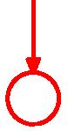
D-separation – Cases Blocking a Path
Case 1: Observing a parent in a “fork” blocks a path.
Case 2: Observing a variable in a “chain” blocks a path.
Case 3: Not observing a child in a “v-structure” blocks a path.
We say that variables are “d-separated” if every path between them is blocked.
Case 1
Case 2
Case 3

Slide 24
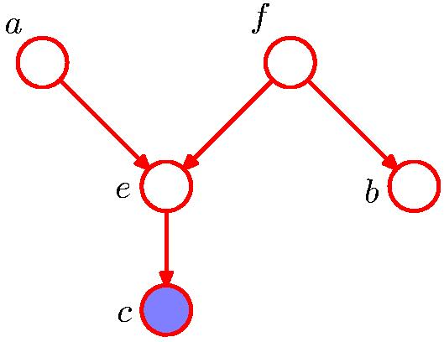

D-separation – Example of Burglary
Burglary
Earthquake
Alarm
Stuff is missing
Neighbor calls police
Notes:
Case 3 and Case 3 ii: explaining away phenomenon.

Slide 25




D-separation – Example of I.I.D Data
Plate notation
A Bayesian framework as the parameter $θ$ is considered as a random variable.
Without observing $θ$, knowing $x_{1}$ tells us something about $x_{2}$.
Observing $θ$, the knowledge of $x_{1}$ is “irrelevant”.

Slide 26
Learning and Inference in DAGs

Slide 27


Learning in Belief Networks
Learning: estimation of the parameters, and in some cases, the topology of the network, from data.
Assume the parameters for each conditional probability distribution (CPD) $p\left(x_{i} \right| pa(x_{i}))$ are globally independent, and all nodes are fully observed. Further assume i.i.d. data $\{x^{n}\}$, then the log-likelihood function decomposes into a sum of local terms, one per node:
E.g., learning the 4-node DAG is like learning four separate small DAGs.

Slide 28

Learning in Belief Networks
Assume $\{x_{i}\}$ are discrete random variables
For node $i$ :
If some nodes are not observed (hidden), we need to do need inference to impute the missing data.

Slide 29

Inference in Graphical Models
Common inference tasks in graphical models:
Compute univariate marginals $p(x_{i})$
Compute univariate conditional $p(x_{i}|x_{j})$
Finding $x$ with highest joint probability ${argmax}_{x} p(x)$
Compute the evidence of visible nodes $p\left(x_{V}\right)=\sum_{x_{H}}{p(x_{H},x_{V})}$
Exact inference algorithms
Bucket elimination
Belief propagation on tree networks
Junction tree algorithms
Burglary
Earthquake
Alarm
Stuff is missing
Neighbor calls police
Approximate inference techniques
Loopy belief propagation
Variational inference
Markov chain Monte Carlo

Slide 30

Inference in Graphical Models
Consider the following two inference tasks:
Compute univariate marginals $p(x_{i})$
Compute univariate conditional $p(x_{j}|x_{i})$
A naïve summation needs to enumerate over an exponential number of terms ($O(K^{N})$ if every discrete variable $x_{i}$ has $K$ states).
One of the motivation of using graphical models is the ability of making inference in very large-scale systems.

Slide 31


Bucket Elimination for Belief Networks
Task: compute the marginal $p\left(f\right)$
We firstly summation over the end nodes $e,b$ and $c$
Then sum over nodes $a$ and $g$
Comments:
On trees, the computation time scales linearly with network sizes.
Encounter difficulties in loopy networks.

Slide 32
Undirected Graphical Models (UGMs)

Slide 33





Markov Random Fields (Markov Networks)
Probability distributions defined on an undirected graph:
$ψ_{c}(x_{c})$ is a non-negative potential function (not normalized).
$Z=\sum_{x}{\prod_{c=1}^{M}{ψ_{c}(x_{c})}}$ is called the partition function ensuring normalization of $p(x_{1},…,x_{N})$.
The most common choice is a pairwise model:
The “edge potentials” $ψ_{ij}$ are defined on edge $(i,j)$ of an undirected graph $G(V,E)$.
Factor graph

Slide 34




Pairwise Undirected Graphical Models
Special cases:
Multivariate Gaussian corresponds to specific choice of the $φ$ and $ψ$ functions.
AKA “Gaussian graphical models” or “Gaussian random fields”.
Ising model for binary $x_{i}∈\{+1,−1\}$ or $x_{i}∈\{1,0\}$
$φ_{i}\left(x_{i}\right)=\exp{(h_{i}x_{i})}$, $ψ_{ij}\left(x_{i},x_{j}\right)=exp(−J_{ij}x_{i}x_{j})$, (a log-linear model in statistics!)
Stems from statistical physics
App in machine learning: Hopfield networks, Restricted Boltzmann Machines (RBM)
Hopfield net for associative memory: $J_{ij}=\sum_{μ}{ξ_{i}^{μ}ξ_{j}^{μ}}$.
Modern development: “Hopfield is all you need” [2020].
RBM as a powerful generative model for binary data.
Historically successful for pre-training deep networks [2006].
Notes:
Modern Hopfield:
1. Larger capacity
2. Relation to attention and transformer.
RBM: Hinton’s work [Science 2006] on deep belief net.

Slide 35


Converting Directed to Undirected Graphs

Slide 36








Converting Directed to Undirected Graphs
When a node have more than one parents, we need to “marry” them (by adding links)
moralization

Slide 37




Converting Directed to Undirected Graphs

Slide 38


Comparing Undirected and Directed GMs
Both can conveniently represents conditional independence
For an Undirected GM, if $C$ separates all nodes in $A$ from all nodes in $B$.
Neither DAGs or UGMs are “more powerful” than the other.
Set of independences in DAG cannot always be written as UGM (and vice versa). E.g.,
UGMs cannot reflect independences in common child graph:
DAGs cannot reflect independences in 3-node loop:
DAGs are often used to work with conditionals, causal directions, etc.
UGMs are often used when there are no obvious directions (like images).

Slide 39

UGM Application – Image denoising
Encourage neighboring pixels to have similar values (a prior of images).

Slide 40



UGM Application – Human Pose Estimation
[Nowozin and Lampert, “Structured Learning and Prediction”, 2011]
Conditional random field $p(y|X)$, $X=image$, $y=pose$.
Do not model the distribution of the image.
A discriminative model.

Slide 41
Learning and Inference in UGMs

Slide 42

Learning in Markov Random Fields
In parallel with DAGs, learning in UGMs refers to estimation of the parameters, and in some cases, the topology of the network, from data.
There exist many methods. Here we briefly introduce maximum likelihood (MLE) learning.
Remind the Markov random field as a UGM model
Given a set of (assumed) i.i.d. training data $tr=\{x^{m}\}$, the log likelihood is
which can be maximized by gradient descent.

Slide 43
Learning in Markov Random Fields
Log-likelihood gradient:
The second term is obtained by using
EM algorithms if some variables are not observed.
Requires inference.
#P-hard in general graphs.
Need approximations when learning (e.g., variational methods, MCMC)
Notes:
Inference is a very important task in GMs.

Slide 44

Inference on a Chain

Slide 45


Inference on a Chain

Slide 46
Inference on a Chain

Slide 47

Inference on a Chain
To compute local marginals:
Compute and store all forward messages: $μ_{α}(x_{n})$
Compute and store all backward messages: $μ_{β}(x_{n})$
Then
The messages $μ_{α}\left(x_{n−1}\right),μ_{β}(x_{n+1})$ etc can be reused to compute marginals elsewhere.

Slide 48

Inference by Belief Propagation in UGMs
Above example is a special case of belief propagation (BP) algorithm.
Called sum-product algorithm when the inference task is to compute marginals $p(x_{n})$.
In contrast, max-product algorithm or max-sum algorithm is used when computing ${argmax}_{x} p(x)$.
Belief propagation algorithm involves passing messages $μ_{α}\left(x_{n}\right),μ_{β}(x_{n})$ on the chain
A type of message-passing algorithm.
Exact on tree networks.
Only local computation; very efficient
Key idea: Distributive Law: $ab+ac=a(b+c)$

Slide 49





Factor Graphs
A very general representation for graphical models.
The example of chain:

Slide 50





Factor Graphs from Directed Graphs

Slide 51

Factor Graphs from Undirected Graphs
Notes:
Remind log-linear model. (Undirected graph can be ambiguous.)

Slide 52



Sum-Product Algorithm for Factor Graphs
Task: compute the marginal $p\left(x_{i}\right), ∀i$
It does so by iteratively computing the messages
Upon convergence,

Slide 53


The Messages
Intuitively, the “probability” of $x_{i}$ when node $i$ interacts with factor $a$.
Representative of the contribution from the “leftmost” part of the tree.
Intuitively, the “probability” of $x_{j}$ when node $j$ interacts with its neighboring factors except $a$.

Slide 54
Sum-Product Algorithm for Factor Graphs
To compute local marginals on tree networks
Pick an arbitrary node as root
Compute and propagate messages from the leaf nodes to the root, storing received messages at every node.
Compute and propagate messages from the root to the leaf nodes, storing received messages at every node.
Compute the product of received messages at each node for which the marginal is required, and normalize if necessary.

Slide 55



Sum-Product: Example (1)
(A special case where $Z=1$.)
Initialization for leaf nodes:

Slide 56


Sum-Product: Example (2)

Slide 57


Sum-Product: Example (3)

Slide 58


Sum-Product: Example (4)
(Remark: need to normalize $p(x_{j})$ by a normalization factor $Z_{j}$ if necessary.)

Slide 59


Max-Sum Algorithm for Factor Graphs
Task: compute the most likely state of all nodes in the graph $x^{max}={argmax}_{x} p(x)$
Observe:
Again, make use of distributive law: $\max\left(a+b, a+c\right)=a+max⁡(b,c)$
Similar treatment as in sum-product algorithm, but with modifications:
Be careful of the ambiguity of $\max{(b,c)}$ when $b=c$.
See Bishop Chap. 8.

Slide 60

Loopy Belief Propagation
Belief propagation (BP) algorithm provides exact inferences for tree networks.
For loopy networks, BP is no longer exact and may not converge. But interestingly, it still works in many problems in loopy networks and yields valuable results.
In such cases, we simply called it loopy belief propagation, which provides approximate inferences.
More formally, BP can be viewed as a variational inference method, which approximate the high-D distribution $p(x)$ by to so-called Bethe measure $q_{Bethe}(x)$.
Minimize $D_{KL}(q_{Bethe}(x)\text{||}p(x))$ gives BP.
Generalized belief propagation is derived by using a more sophisticated $q(x)$.
[Y. Kabashima and D. Saad 1998]
[J. S. Yedidia, W. T. Freeman and Y. Weiss, 2001, 2005]

Slide 61
Belief Propagation Applications in Information Theory and Computer Science (optional)

Slide 62


BP Application – Error Correcting Code
Error correcting codes:
Used for controlling errors in data over unreliable or noisy communication channels.
Ubiquitous applications:
Mobile phones
Satellite communication
Hard disks, CD’s
…
Basic ideas: Redundancy of code-words in a smart way.
Claude Shannon
Notes:
Simplest redundancy: replicate the code-words, but clearly non-optimal.
Shannon gave the theoretical channel capacity (noisy-channel coding theorem), which laid the foundation of information theory.

Slide 63




BP Application – Error Correcting Code
Low Density Parity Check (LDPC) code
Redundancy by parity-check bits
Factor graph representation (graphical model !):
R. Gallager
A bit of history
Belief propagation was in fact first proposed by R. Gallager (1962) for decoding LDPC code (before J. Pearl’s Bayesian networks).
Capable of approaching the best theoretical performance (the Shannon limit).
LDPC code (or Gallager code) has been neglected for decades until the mid-1990s, because computers at that time were not powerful enough to implement BP…
Decoding by running belief propagation on this graphical model.
[M. Mézard and A. Montanari, “Information, Physics, and Computation”, 2009]
Notes:
LDPC: “a bit of 21st-century coding that happened to fall in the 20th century”

Slide 64



BP Application – K-SAT
Computational complexity: P, NP and NP-complete
P: problems solvable in polynomial time.
NP: solution verifiable in polynomial time.
NP-complete: a class of NP problems where every other NP problem can be reduced to in polynomial time (“hardest” in NP).
P = NP or P != NP ?
Arguably the most important open problem in computer science.
K-SAT (with K>2): the first problem proven to be NP-complete.
$x,y,z∈\{True, False\}$
K-SAT: find a configuration of $(x,y,z)$ s.t. the above formula holds.
Notes:
Note: NP-hard is different from NP.

Slide 65




BP Application – K-SAT
K-SAT: the first problem proven to be NP-complete.
By definition of NP-completeness, other NP-complete problems (such as graph coloring, Travelling salesman problem) can be reduced to K-SAT in polynomial time.
Verifying the solution is “easy”, but finding the solution can be very “hard”.
- Do you think you can do the math?
- No.
But if someone else does it,
I can double check the crap out of it.

Slide 66







BP Application – K-SAT
($N$ variables, $M$ constraints (factors))
K-SAT problem as a graphical model
Belief propagation can be applied for finding a solution in some instances of K-SAT problems.
BP fails if the constraints density $α=M/N$ is high.
Physics methods to unveil the solution structure, which helps to understand computational complexity and suggests more powerful message-passing algorithms.
Phase transitions when varying $α$.
[M. Mézard and A. Montanari, “Information, Physics, and Computation”, 2009]
[M. Mézard, G. Parisi, and R. Zecchina, Science 2002]

Slide 67



BP Application – Compressed Sensing
We’ve learnt 1st order methods for compressed sensing using the proximal gradient, e.g., iterative soft-thresholding algorithm (ISTA).
Convergence of ISTA is not so good.
Compressed sensing (e.g., basis pursuit denoising) as a graphical model
Advantages:
Bayesian framework.
Easy to incorporate priors other than $ℓ^{1}$ norm.
Notes:
$ψ_{i}$ : prior
$ψ_{a}$ : likelihood

Slide 68



BP Application – Compressed Sensing
We can run BP on this graphical model. But it would be inefficient as the factor graph is densely connected (need $O(MN)$ messages).
Suppose the measurement matrix $A$ is a random matrix (e.g., by design to satisfy RIP), it is possible to derive a much simplified approximated version of BP, called the approximate message passing (AMP) algorithm:
$η(⋅)$ is the soft thresholding operator.
Not much complicated than ISTA, but better performance.
[D. Donoho, A. Maleki and A. Montanari, 2009, 2011]
Notes:
Reference by Donoho et al.:
[1] “Message passing algorithms for compressed sensing”, PNAS 2009.
[2] “How to Design Message Passing Algorithms for Compressed Sensing”, lecture note 2011.

Slide 69
Hidden Markov Models

Slide 70






Motivation – Modeling Sequential Data
Audio signal:
Time series:
Natural language:
Biomacromolecule:
Stock price
Dec 1999 – Oct 2000
I like to study pattern recognition.

Slide 71






Hidden Markov Models (HMM)
The observed sequential signals $\{x_{n}\}$ have correlations $\left\langle x_{n}x_{m}\right\rangle ≠0$, which we want to model.
Assume that there is a hidden (explanatory) state $z_{n}$ for each $x_{n}$, conditioned on which $x_{n}$ is independent of the other signals.
The hidden states follow a stochastic dynamics (for simplicity, assume a Markov chain). The resulting model is an HMM:
A generative model for correlated sequential data.
We mostly consider $\{z_{n}\}$ as discrete variables.

Slide 72


Hidden Markov Models (HMM)
Note that the $x_{n}$ can be continuous even with discrete clusters $z_{n}$.
E.g., data come from a mixture of Gaussians, with cluster changing in time following $p(z_{n}|z_{n−1})$
If the $z_{n}$ are continuous, it’s often called a state-space model or linear dynamical system.
If everything is Gaussian, it leads to Kalman filtering.

Slide 73



Inference in HMM
Common inference tasks
Filtering: compute the belief state $p(z_{n}|x_{1:n})$ online
Smoothing: compute $p(z_{n}|x_{1:N})$ offline
Prediction: compute $p(x_{N+1}|x_{1:N})$
Decoding (MAP est.): compute $argmax_{z_{1:N}} p(z_{1:N}|x_{1:N})$
…
Naively, one can represent the HMM as a factor graph and apply belief propagation as usual.
Here we derive them in a (probabilistically) more transparent way.

Slide 74


Forward-backward Algorithm (1)
Recall that for a Markov random field on a chain, inference boils down to passing messages forward and backward:
Expect similar procedures for HMM.
Consider the task of computing $p(z_{n}|x_{1:N})$.
The key idea is that when conditioned on $z_{n}$, $x_{1:n}$ and $x_{n+1:N}$ are independent:

Slide 75

Forward-backward Algorithm (2)
The smoothed posterior marginal $γ_{n}\left( j \right) :=p\left(z_{n}=j \right| x_{1:N})$ can be computed as
Define the filtered belief state $α_{n}\left( j \right) :=p\left(z_{n}=j \right| x_{1:n})$
and the conditional likelihood $β_{n}\left( j \right) :=p\left(x_{n+1:N} \right| z_{n}=j)$
Then: $γ_{n}\left( j \right)=\frac{α_{n}\left( j \right) β_{n}\left( j \right)}{{Norm}_{n}}$.
Notes:
$α_{n}\left( j \right)$ relates $z_{n}$ to the past, to be computed forward;
$β_{n}\left( j \right)$ relates $z_{n}$ to the future, to be computed backward.

Slide 76
Forward-backward Algorithm (3)
The filtered belief state:
Notes:
Notice the sum-product form.

Slide 77


Forward-backward Algorithm (4)
The conditional likelihood:
The resulting forward-backward algorithm is equivalent to the sum-product algorithm.
Time complexity: $O(K^{2}N)$; space complexity $O(KN)$ ($K$ is the number of states of $z_{n}$).
Notes:
Notice the sum-product form.

Slide 78

The Viterbi Algorithm (1)
Task: computing the most probable sequence of $z_{1:N}^{∗}$ (also called decoding): $z^{∗}=argmax_{z_{1:N}} p(z_{1:N}|x_{1:N})$
Method: run max-sum algorithm on the graphical model.
Called the Viterbi algorithm in HMM.

Slide 79
The Viterbi Algorithm (2)
Max-sum algorithm:
Applied to HMM:
Viterbi Algorithm (combining above two into one equations):
Notes:
Initial condition: $μ_{→z_{1}}\left(z_{1}\right)=\log{p(z_{1})}+\log{p(x_{1}|z_{1})}$

Slide 80

Learning in HMM
Parameters $θ$ of an HMM include the transition and emission probabilities, as well as the initial conditions for the Markov dynamics.
Learning (or training) can be done by maximum likelihood: $\max_{θ}{ p(X^{train}|θ)}$.
As there are unobserved states $\{z_{n}\}$, direct optimization of the likelihood is difficult. We usually employ Expectation-Maximization (EM) algorithms for training in such cases.
In HMMs, this is called the Baum-Welch algorithm.
EM algorithm proceeds by iterating:
E-step: compute $p(Z|X,θ^{old})$, then compute the complete-data log-likelihood $Q\left(θ,θ^{old}\right)=\sum_{Z}{ p(Z|X,θ^{old})}\log{p(X,Z|θ)}$
M-step: $\max_{θ} Q\left(θ,θ^{old}\right)$

Slide 81

EM for Learning HMM (1)
E-step: compute the complete-data log-likelihood $Q\left(θ,θ^{old}\right)=\sum_{Z}{ p(Z|X,θ^{old})}\log{p(X,Z|θ)}$
M-step: $\max_{θ} Q\left(θ,θ^{old}\right)$
Observed that learning requires inference.
Introduce the following notations for later convenience:
and new latent variables $z_{n,k}$; (1) if $z_{n}=k$, then $z_{n,k}=1$, (2) otherwise $z_{n,k}=0$.
Also denote:
Notes:
$z_{n,k}$ is the one-hot representation of $z_{n}$.

Slide 82

EM for Learning HMM (2)
E-step: compute the complete-data log-likelihood
Recall for HMM (assume ${\{z}_{n}\}$ are $K$-state discrete variables):
Complete-data log-likelihood:

Slide 83

EM for Learning HMM (3)
M-step: $\max_{θ} Q\left(θ,θ^{old}\right)$
Use any optimization method (notice that the parameters are probabilities, thus normalized)
$γ(z_{n,k})$ is like responsibility in Gaussian mixture models.
If $\{x_{n}\}$ are multinomial observables (with $D$ states),

Slide 84

EM for Learning HMM (4)
So EM relies on inference of the following marginal posterior probabilities
We have already calculated the smoothed posterior marginal $γ(z_{n})$ by the forward-backward algorithm:
Similarly for the joint posterior $ξ(z_{n−1},z_{n})$:

Slide 85


HMM Applications
Widely used in time-series analysis
Hidden states with desired meaning.
Or as a black-box probabilistic model for sequences $\{x_{t}\}$ with interdependencies.
Some NLP tasks
part-of-speech tagging
Genetics and molecular biology
…

Slide 86


HMM Application – Who is Guarding Who?
There is a lot of data on scoring/offense of NBA basketball players.
Every point and assist is recorded, more scoring gives more wins and $$$.
But how do we measure defense (“stopping people from scoring”)?
We need to know who each player is guarding (which is not recorded)
HMMs can be used to model who is guarding who over time.
http://www.lukebornn.com/papers/franks_ssac_2015.pdf
Notes:
Cannot find the appendix of the paper…

Slide 87
Conditional Random Fields (Optional)

Slide 88


Shortcomings of HMM
HMMs are generative models which capture dependences between each state and only its corresponding observation.
Apparently, the assumed density $p\left(X\right)=\sum_{Z}{ p(X,Z)}$ in HMMs can be too simplistic for many situations.
We can increase the modeling powers of HMMs through some generalizations, but it comes at a price of increasing the complexity.
In many tasks, we do not care about the distribution $p(X)$ of the signals $X$, but how the signal $X$ can be used to predict its label $y$.
That is, we want to model the conditional distribution $p(y|X)$, which is a discriminative model.
In graphical models, this is accommodated by conditional random fields (CRF).

Slide 89


Generative Models vs Discriminative Models
A discriminative model does not “waste resources” modeling the signal $X$, which is allowed to be very complex.
However, it lacks the ability to generate samples by $X \sim P\left(X\right)$, unlike a generative model.

Slide 90

Conditional Random Fields (CRF)
Definition: conditioned on $x$, the distribution of $y$ follows a Markov random field (MRF):
A set of feature functions $\{f_{k}\left(x,y_{c}\right)\}$ (hand-picked or learnt, feature engineering!) is used to link the global input signal $x$ to local label $y_{c}$ on a clique $c$.
For simplicity, it is usual to assume $ψ_{c}\left(y_{c} \right| x, θ)=\exp{(θ_{c}^{⊤}⋅f(x,y_{c}))}$
This is a log-linear model.
More complex models can be use to parametrized $ψ_{c}\left(y_{c} \right| x, θ)$ (e.g., a neural network).

Slide 91


Linear-chain CRFs
The labels $\{y_{n}\}$ form a chain graph MRF when conditioned on $x$.
A log-linear model is usually adopted.
It permits rich, overlapping features of the input signal $x$, which overcomes the shortcomings of limited expressiveness of HMMs.

Slide 92

General CRFs
E.g., hierarchal graph structures for the “label” dependencies:

Slide 93

Learning and Inference in CRFs
For a given input $x$ and parameters $\{λ,μ\}$, inference can be performed similarly as before, e.g., by message-passing algorithms:
Sum-product algorithm (forward-backward for chains) for computing marginals $P(y_{n}|x)$.
Max-sum algorithm (Viterbi for chains) for computing the most probable labels $y^{∗}$.
Learning for CRFs is similar as for MRFs. This is more complicated than HMMs, due to the dependencies of the partition function $Z(λ,μ)$ on the parameters.
If both the inputs and the labels are supplied in the training set $\{(x^{m},y^{m})\}$, we can use maximum likelihood for learning (e.g., through (stochastic) gradient descent).
If the feature set size is large, use regularizations ($ℓ^{2}$ or $ℓ^{1}$ norm of parameters) to control over-fitting.

Slide 94




CRF Applications
Image segmentation
Graphical model to incorporate pixels correlations or contexts of letters.
Improved over local classifiers.
Handwriting Recognition
Potential functions to penalize unrealistic poses.
Pose Estimation

Slide 95
Implementation (pedagogical)
Matlab codes available from Prof. David Barber’s website (companion with BRML):
http://web4.cs.ucl.ac.uk/staff/D.Barber/pmwiki/pmwiki.php?n=Brml.Software
(contains demos on belief nets, HMMs, CRFs, belief propagation, etc.)
pgmpy in Python: https://pgmpy.org/index.html
infer.NET by Microsoft: https://dotnet.github.io/infer/
…
Or write the code from scratch to improve your understanding !

Slide 96
Summary
Graphical models provide a general framework and many tools for probabilistic modeling and pattern recognition.
Intuitive to encode prior knowledge in the graph structure.
General inference algorithms.
Many applications.
Features are usually presumed
GMs alone lack the power for representation learning?
What we have not covered
Junction tree algorithm (exact inference)
MCMC, KL variational inference, expectation propagation (approximate inference)
Structure learning, model selection, …

